Slide 1
Network Security
National Taiwan University
of Science and Technology

Slide 2
Neural Network

Slide 3

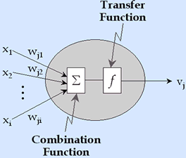

Slide 4
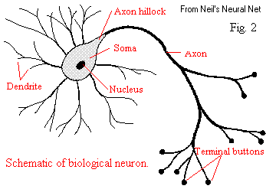
What is a Neural Network?
A method of computing, based on the interaction of multiple connected processing elements
Has the basic characteristics of human brain functions: learning, memory, and inductive

Slide 5
What can a Neural Net do?
Compute a known function
Approximate an unknown function
Pattern Recognition
Signal Processing
Learn to do any of the above

Slide 6
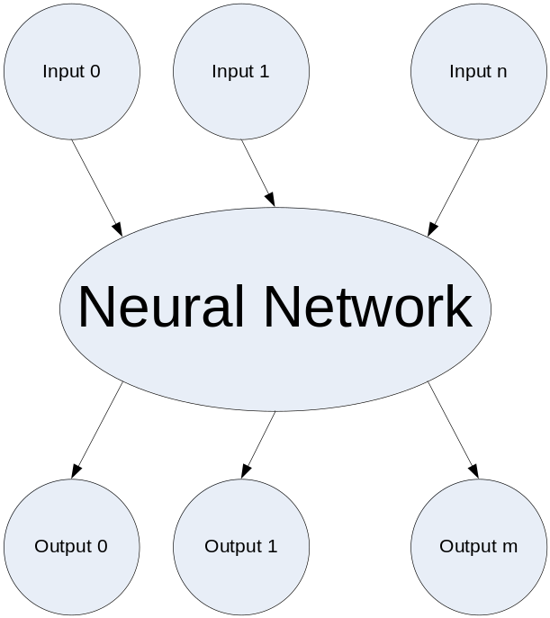
Basic Concepts
A Neural Network generally maps a set of inputs to a set of outputs
Number of inputs/outputs is variable
The Network itself is composed of an arbitrary number of nodes with an arbitrary topology

Slide 7
Basic Concepts
Neural networks are typically organized in layers.
Layers are made up of a number of interconnected 'nodes' which contain an 'activation function'.
Patterns are presented to the network
  input layer
  hidden layers
  weighted connections
  output layer

Slide 8
Architecture of Neural Networks
I
H
I
O
H
I
O
H
I
Input Layer
Hidden Layer
Output Layer

Slide 9
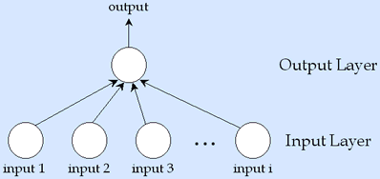
Two Layers with
One Output Node

Slide 10
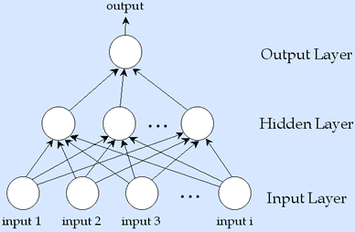
Three Layers with
One Output Node

Slide 11
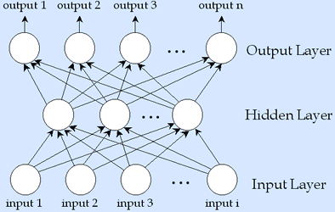
Three Layers with
Multiple Output Node

Slide 12
Neural Network Types
Feed-forward
  Input signals travel though input layer, hidden layers, and output layer
  Require training
  Thought to simulate learning
Feedback
  Network pays attention to it own results and uses the results to adjust errors
  Tend to be constructed rather than trained
  Thought to simulate “instinctual” behavior

Slide 13
Architecture of Neural Networks
Hidden layer between input layer and output layer, these layers are all used for analysis, the equation in the input layer and output layer variables to make it more fitting (fit) data.
There is currently no uniform standard method to calculate the best neural network layer.

Slide 14
The structure of neurons
Neuron is the basic unit of neural network.
A neuron j, a threshold value, from the previous layer of neurons are connected to n input variables X, add a link to each input variable weight w.
Input variables will be combined according to different weights (usually a weighted sum), and threshold to form a combined function, combined value of the function is called potential , the activation function convert potential into the output signal.

Slide 15

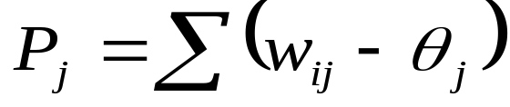
The structure of neurons
n :變數的個數
Xi :第i個輸入變數
Wij :第j個神經元的第i個變數的權重
Θj :是第j個神經元的閾值
Pj :第j個神經元的組合函數
f（•）:神經元的啟動函數
yi=f(Pj) :是第j個神經元的輸出值。
x₁
w_{1j}
x₂
w_{2j}
P_{j}
f(P_{j})
：
：
y_{j}
w_{nj}
x_{n}

Slide 16












₁
input layer
hidden layers
output layer

Slide 17
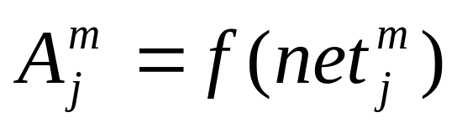
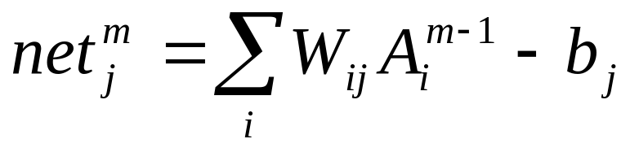
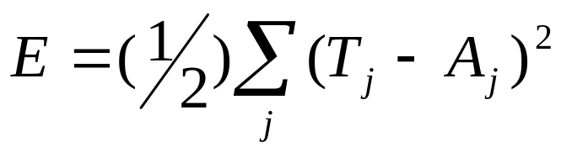
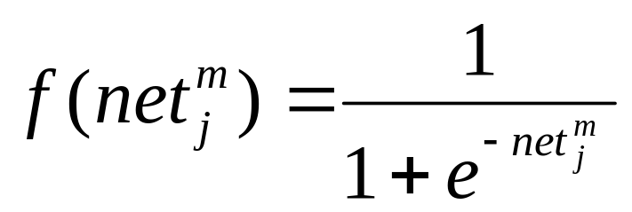
(1)
(2)
(3)
Output Function
利用(1,2)順向計算輸出值,利用(3)反向調整加權值及閥值

Slide 18
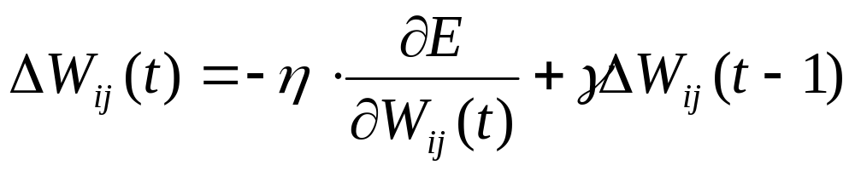
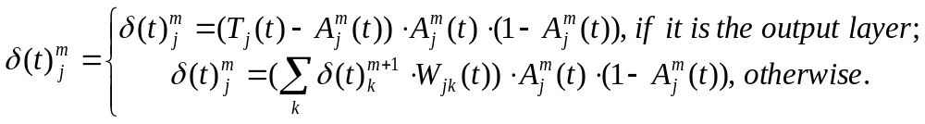
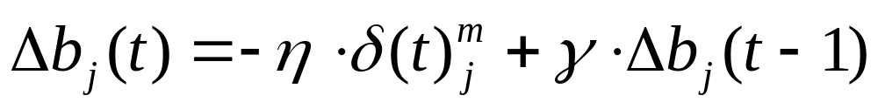
(4)
(5)
(6)
(7)

Slide 19
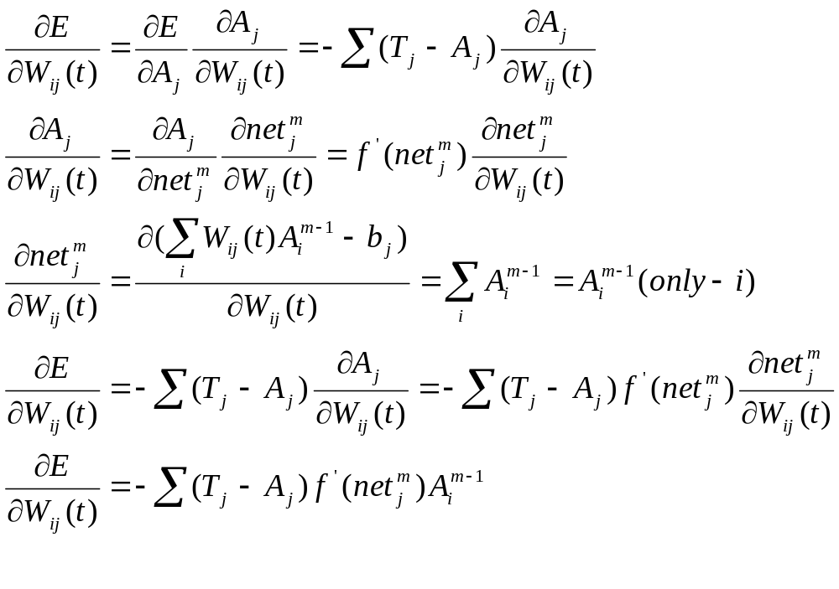

Slide 20
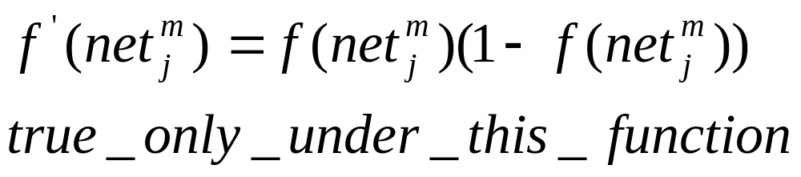
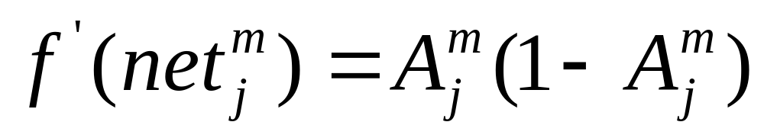

Slide 21
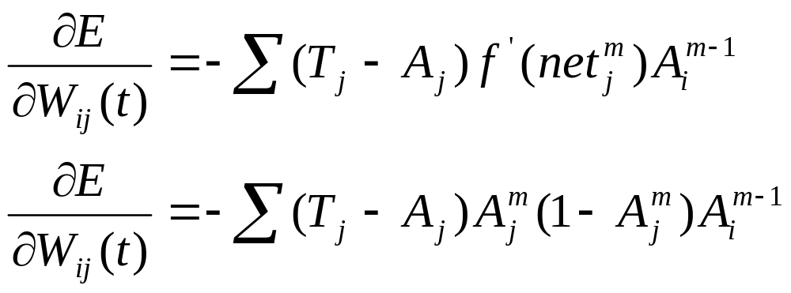
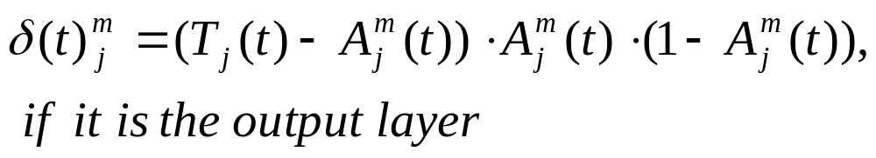

Slide 22
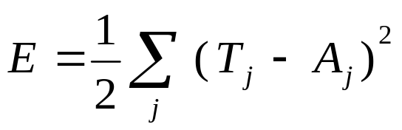
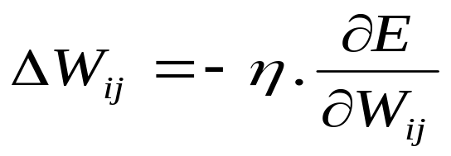
二、網路演算法(盧坤福續) http://www.dee.nuu.edu.tw/~carlu/ai/N1.ppt
2.透過能量函數來降低網路輸出單元之目標輸出值與推論輸出值之差距，
再以最陡坡降法求取能量函數之最小值

Slide 23

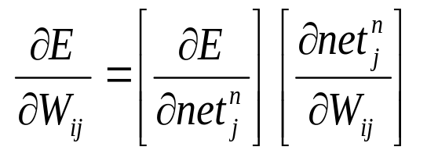
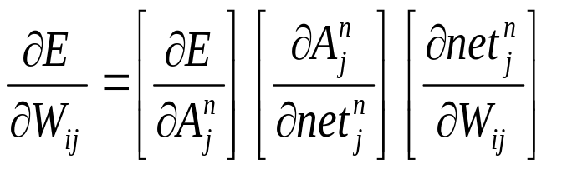
二、網路演算法(續)
3.透過微積分之連鎖率（chain rule），將
轉成下式
及

Slide 24
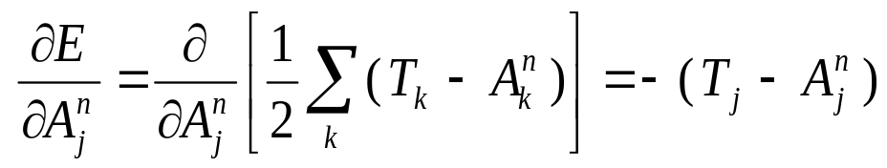
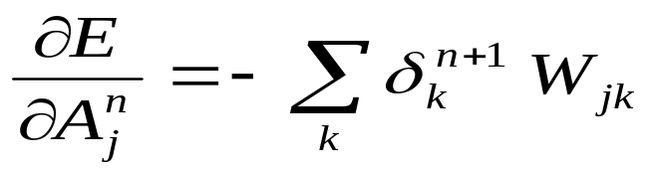
二、網路演算法(續)
3-1 第n層即為最終層，相當於網路之輸出層
3-2 第n層不是最終層，而是網路之隱藏層之一

Slide 25
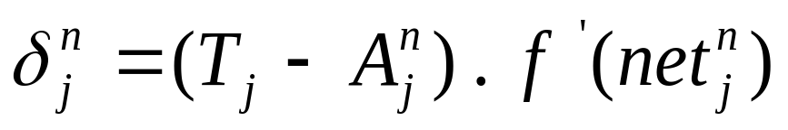
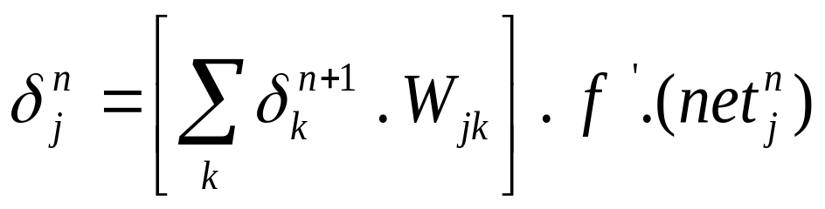
二、網路演算法(續)
4. 總結
4-1 W_{ij}介於輸出層與隱藏層間
4-2 W_{ij}非介於輸出層與隱藏層間

Slide 26
三、評估網路學習效果
‧學習過程通常需要邊學習邊檢驗學習效果
‧事前可將收集資料分成兩個部分，一半作為訓練範例用，另一半作為測試用
‧訓練過程可在每學習幾個學習循環，即將測試範例載入，以供檢視網路之誤差程度是否收斂

Slide 27
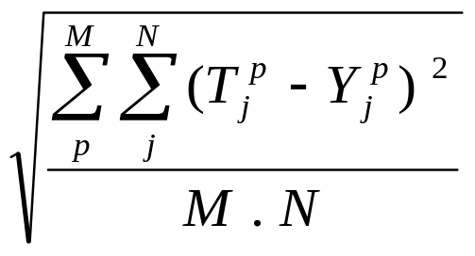

三、評估網路學習效果(續)
誤差程度之評估方式
‧誤差均方根法
‧總錯誤率

Slide 28
四、網路學習過程
學習過程可分成八個步驟
1.設定網路參數：諸如網路種類、層樹、處理單元樹、網路連結等。
2.使用均勻分配隨機亂數，產生加權值矩陣與閥值向量初始值。
3.輸入一個訓練範例之輸入向量X，以及一個目標輸出向量T。

Slide 29
四、網路學習過程(續)
4.計算推論輸出向量Y
5.計算差距量δ
6.計算加權值矩陣修正量，以及閥值向量修正量
7.更新加權值及閥值
8.重複步驟3到7，直到收斂為止。
步驟4:順向計算輸出
步驟5,6,7:反向調整加權值及閥值

Slide 30
五、網路回想過程
回想過程在於求取待求解問題之輸出向量值
可依下述四個步驟來進行
1.設定網路相關參數值。
2.讀入訓練過程所得之加權值矩陣及閥值。
3.輸入待求解問題之輸入向量X。
4.計算推論輸出向量Y

Slide 31
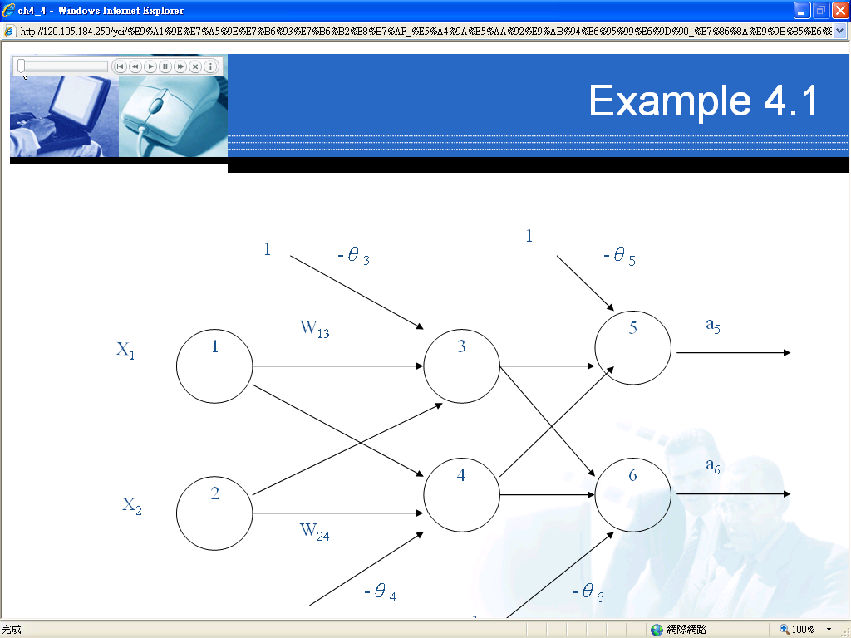
熊雅意 http://120.105.184.250/yai/%E9%A1%9E%E7%A5%9E%E7%B6%93%E7%B6%B2%E8%B7%AF_%E5%A4%9A%E5%AA%92%E9%AB%94%E6%95%99%E6%9D%90_%E7%86%8A%E9%9B%85%E6%84%8F/

Slide 32
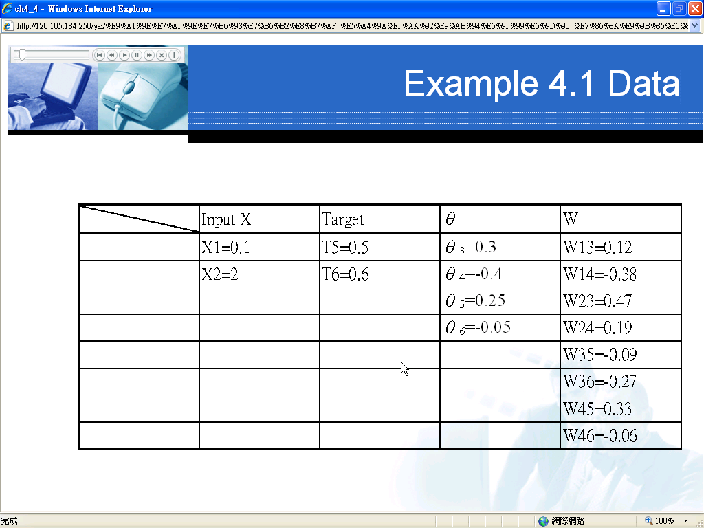

Slide 33
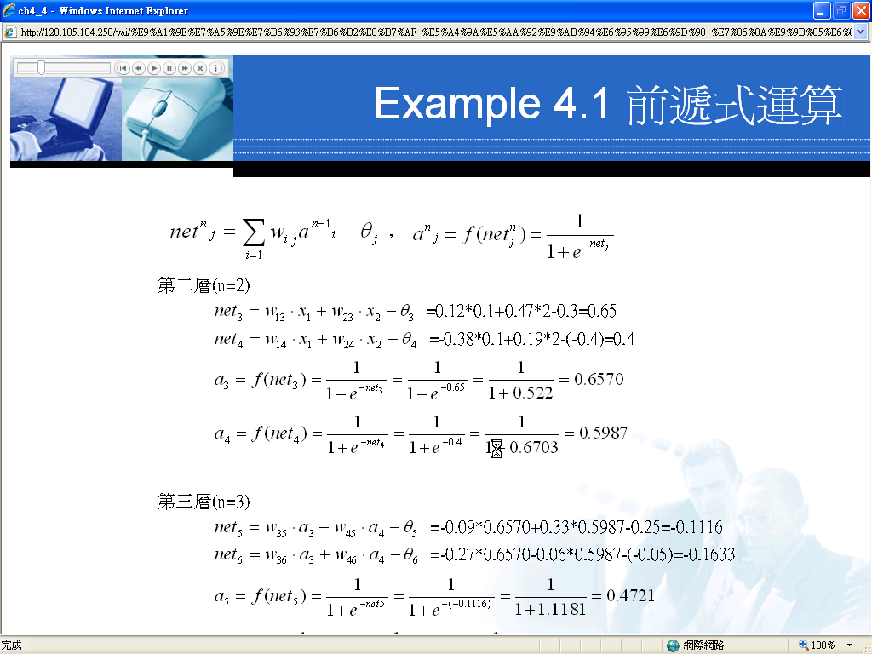

Slide 34
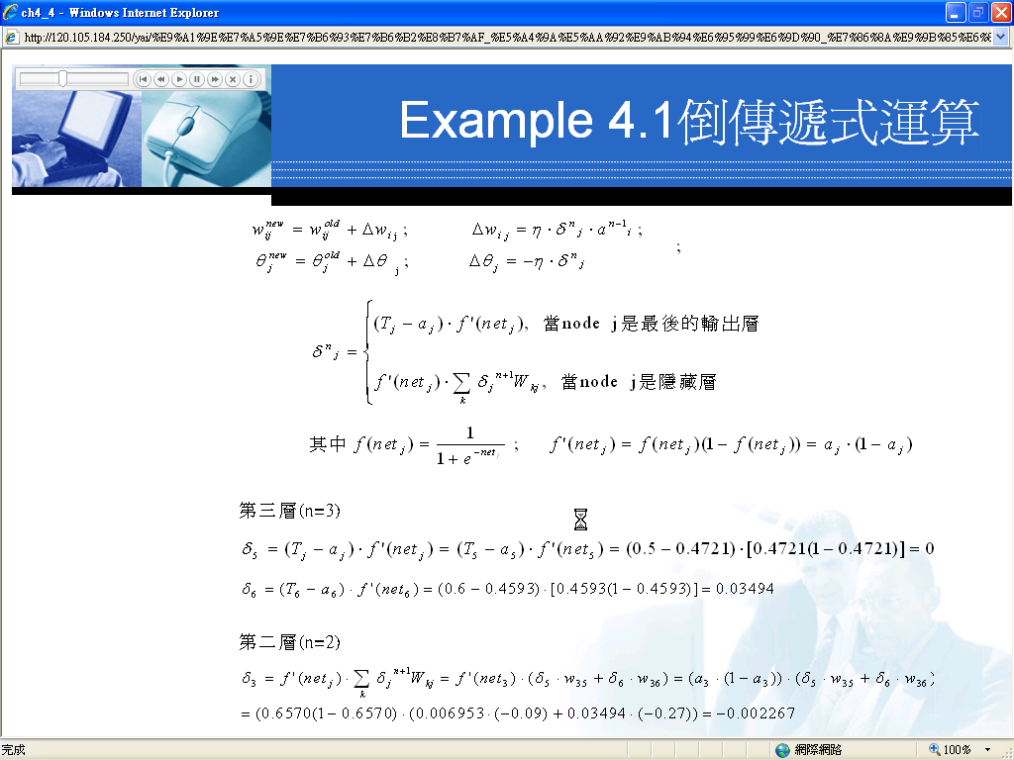

Slide 35
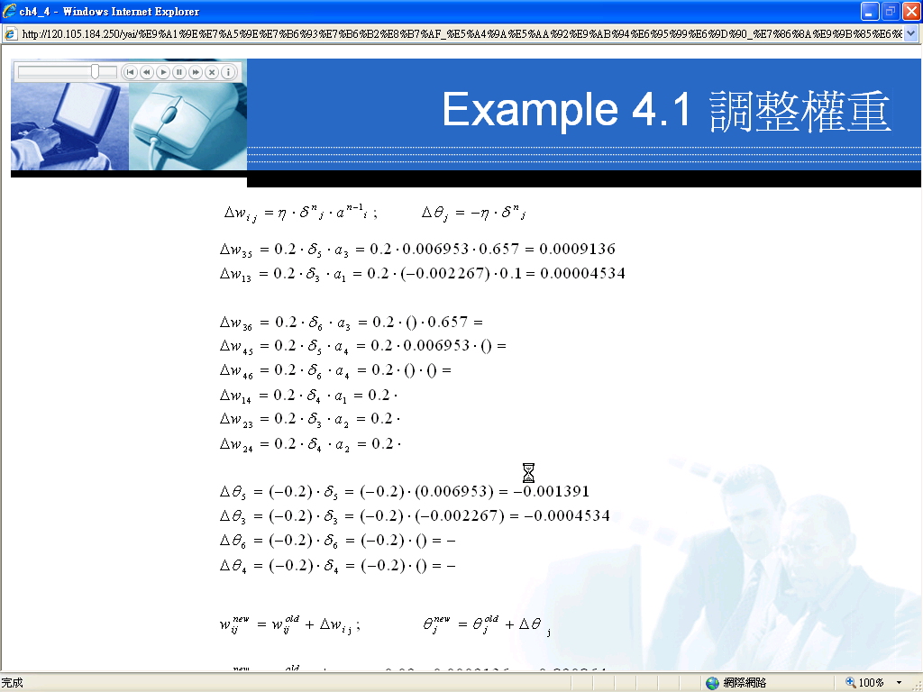

Slide 36
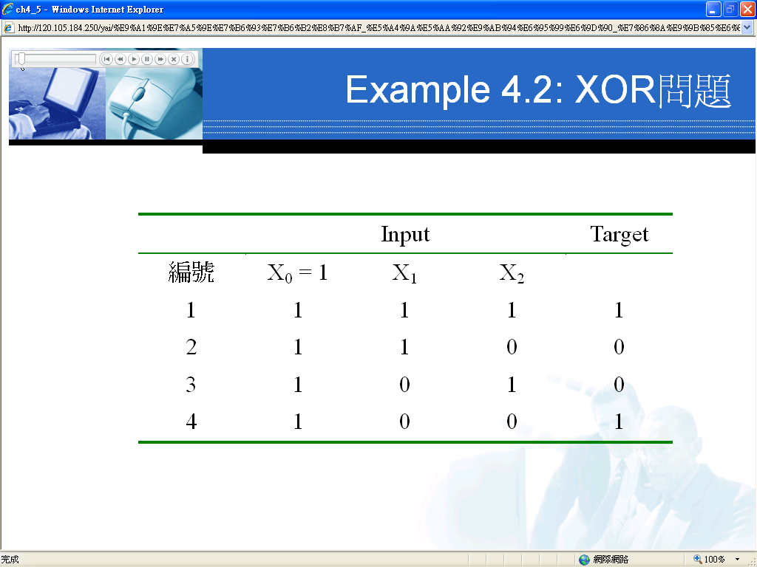

Slide 37


Slide 38


Slide 39
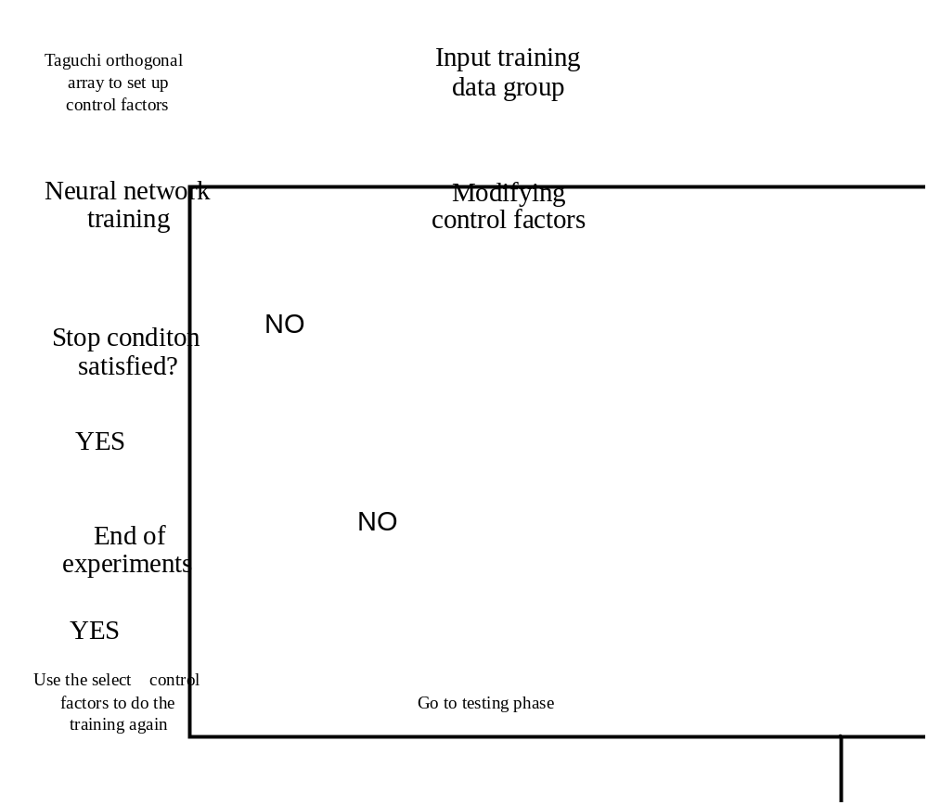

Slide 40
Training of Neural Network
To make the neural network can operate correctly, it must be through training , which allows the neural network to learn over and over again until it can correctly for each input corresponds to the desired output

Slide 41
Training of Neural Network
Neural network learning, it must establish a training sample (training pattern) so that the neural network in the learning process, there is a reference to the establishment of training samples from the actual system input and output, or past experience.

Slide 42
Training of Neural Network
Ex：洗衣機洗淨衣服的時間，與衣服的質料、數量、骯髒的程度有關，因此我們必須先針對不同質料、數量、骯髒的程度的衣服統計出洗衣所需的時間，建立訓練樣本。不同衣服的質料、數量、骯髒程度就是類神經網路的輸入，而洗衣所需的時間則為類神經網路的目標值（target），也就是類神經網路的參考輸出。

Slide 43
Training of Neural Network
The choice of training samples is very important and directly affect the performance of neural network work, if the training samples is not correct, too little or too similar to the work of interval neural networks with the capacity will be greatly reduced.

Slide 44
Training of Neural Network
The more training samples, the more accurate the greater the difference, the capacity of neural network will be.
The purpose of neural network training is to allow the neural network's output closer to the target value, which is the same input into the system and neural network, the output value must be the same.

Slide 45
Training of Neural Network
Neural network weights through learning continuously adjusted, adjusting the weight process is a learning process.
Before training, data collection must be divided into the training data set and test data sets, the weights assigned to the first layer neurons.

Slide 46
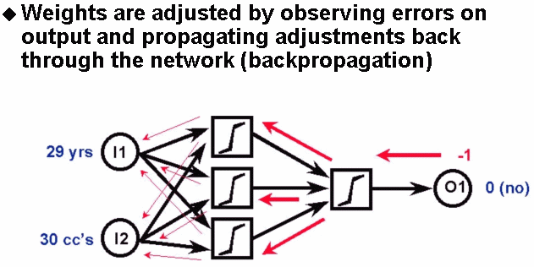
Summary

Slide 47
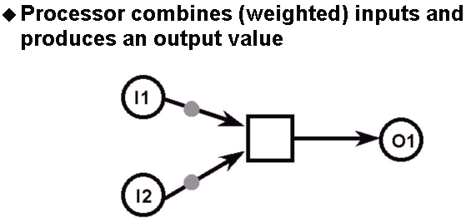
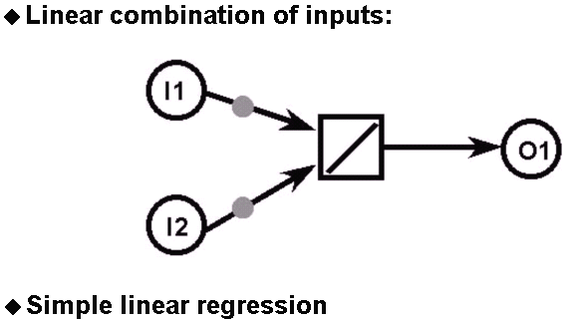
Summary

Slide 48
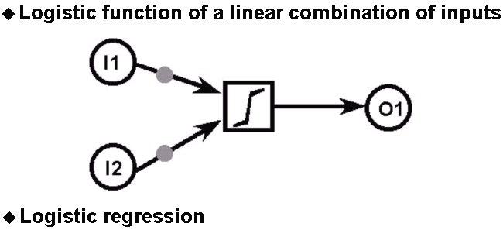
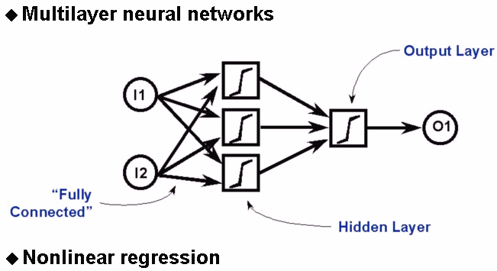
Summary

Slide 49
類神經網路的應用-工業應用
控制器設計與系統鑑別
產品品質分析（例：汽水瓶裝蓋與填充監測、珍珠分級）
機電設備診斷（例：數值電路診斷、類比IC診斷、汽車引擎診斷）
化工程序診斷 （例：化工廠製程故障診斷）
實驗資料模型建立 （例：複合材料行為模型建立）
工程分析與設計（例：鋼樑結構、道路鋪面狀況評級）

Slide 50
類神經網路的應用-商業應用
股票投資（例：大盤基本分析、大盤技術分析、個股技術分析）
債券投資（例：債券分級、美國國庫券利率預測）
期貨、選擇權、外匯投資（例：期貨投資、選擇權投資、外匯投資）
商業信用評估（例：貸款信用審核、信用卡信用審核）
其他商業應用（例：直銷顧客篩選、不動產鑑價）

Slide 51
類神經網路的應用-管理應用
策略管理（例：市場需求量預測方法之選擇、雇工人數規畫）
時程管理（例：排程策略選擇、工作排程）
品質管理（例：管制圖判讀、半導體製造過程所需蝕刻時間估計）

Slide 52
類神經網路的應用-資訊應用
影像辨識系統（例：指紋識別、衛星遙測影像分析、醫學影像識別）
訊號分類
其他資訊應用（例：雷達訊號分類、聲納訊號分類）

Slide 53
類神經網路的應用-科學應用
醫學（例：皮膚病診斷、頭痛疾病診斷、心臟病診斷、基因分類）
化學（例：化合物化學結構識別、蛋白質結構分析）
其他科學應用（例：體操選手運動傷害分析、時間數列分析方法選擇）

Slide 54
Advantage of Neural Network
Neural network can construct non-linear model, and the model accuracy is high.
Good neural network to promote sex, for the unknown input can also get the correct output.
Neural network can accept different types of variables as input, strong adaptability.
Neural networks can be applied to a wide range of areas, the model construction ability.
Neural network with fuzzy inference capabilities that allow input and output variables in a fuzzy, inductive learning is more difficult with this capability.

Slide 55
Disadvantage of Neural Network
Hidden layer neural network can to 1-2 layers, the number can be set to any number, and there is need to set the parameters such as learning rate, work is quite time-consuming.
Neural network to update the iteration threshold, computing a large amount of computer resources-consuming.
Neural network solution has an infinite number of groups, no way of knowing which group the solution for the optimal solution.

Slide 56
Disadvantage of Neural Network
Training process can not know the number of neurons needed, too many or too few neurons will affect the accuracy of the system, often trial and error manner appropriate number of neurons.
Neural network is based on the establishment of numerical structure (including the weighted value of the network) to learn, their knowledge structure is hidden, the lack of explanatory power.

